Slide 1
Bad and Getting Worse?
Prepared By ian mann

Slide 2
1. In all low-income countries across the world today, how many girls finish primary school?
A: 20% B: 40% C: 60%
2. Where does the majority of the world population live?
A: Low-income countries B: Middle-income C: High-income
3. In the last 20 years, the proportion of the world population living in extreme poverty has …
A: almost doubled B: remained more or less the same C: almost halved
4. What is the life expectancy of the world today?
A: 50 years B: 60 years C: 70 years
5. There are 2 billion children in the world today, aged 0 to 15 years old. How many children will there be in the year 2100, according to the United Nations?
A: 4 billion B: 3 billion C: 2 billion
6. The UN predicts that by 2100 the world population will have increased by another 4 billion people. What is the main reason?
A: There will be more children (age below 15)
B: There will be more adults (age 15 to 74)
C: There will be more very old people (age 75 and older)
7. How did the number of deaths per year from natural disasters change over the last hundred years?
A: More than doubled B: Remained about the same C: Decreased to less than half
8. Worldwide, 30-year-old men have spent 10 years in school, on average. How many years have women of the same age spent in school?
A: 9 years B: 6 years C: 3 years
9. In 1996, tigers, giant pandas, and black rhinos were all listed as endangered. How many of these three species are more critically endangered today?
A: Two of them B: One of them C: None of them
10. How many people in the world have some access to electricity?
A: 20 percent B: 50 percent C: 80 percent
11. Global climate experts believe that, over the next 100 years, the average temperature will …
A: get warmer B: remain the same C: get colder

Slide 3




Slide 4
20th Century
Flu epidemic 1918 kills 50m
World War II kills 60m
Tsunamis
Hurricanes
Earth quakes
Plagues of locusts
Infant mortality drops 90%
Maternal mortality drops 99%
Human life span almost 70%
Quality of life & living standards

Slide 5




Challenges and solutions

Slide 6
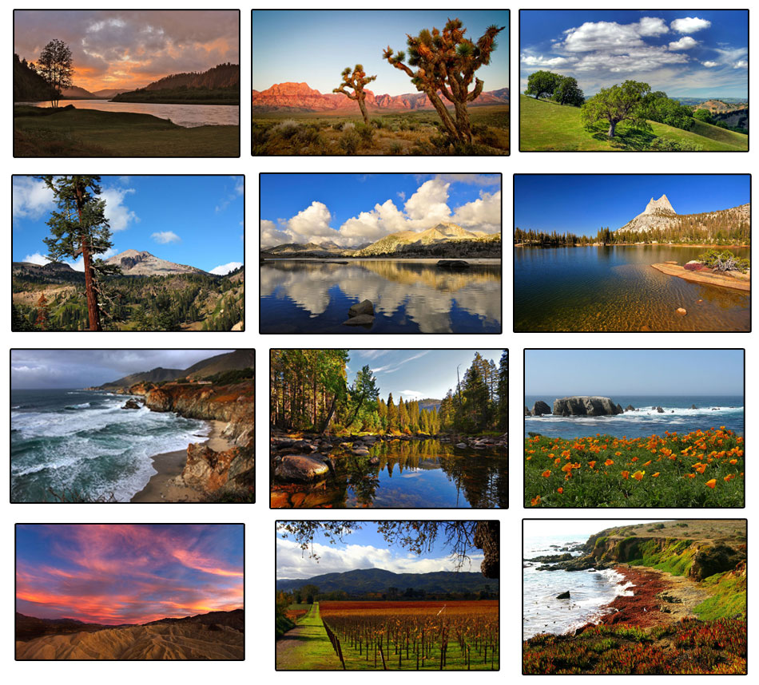
Natural resources

Slide 7
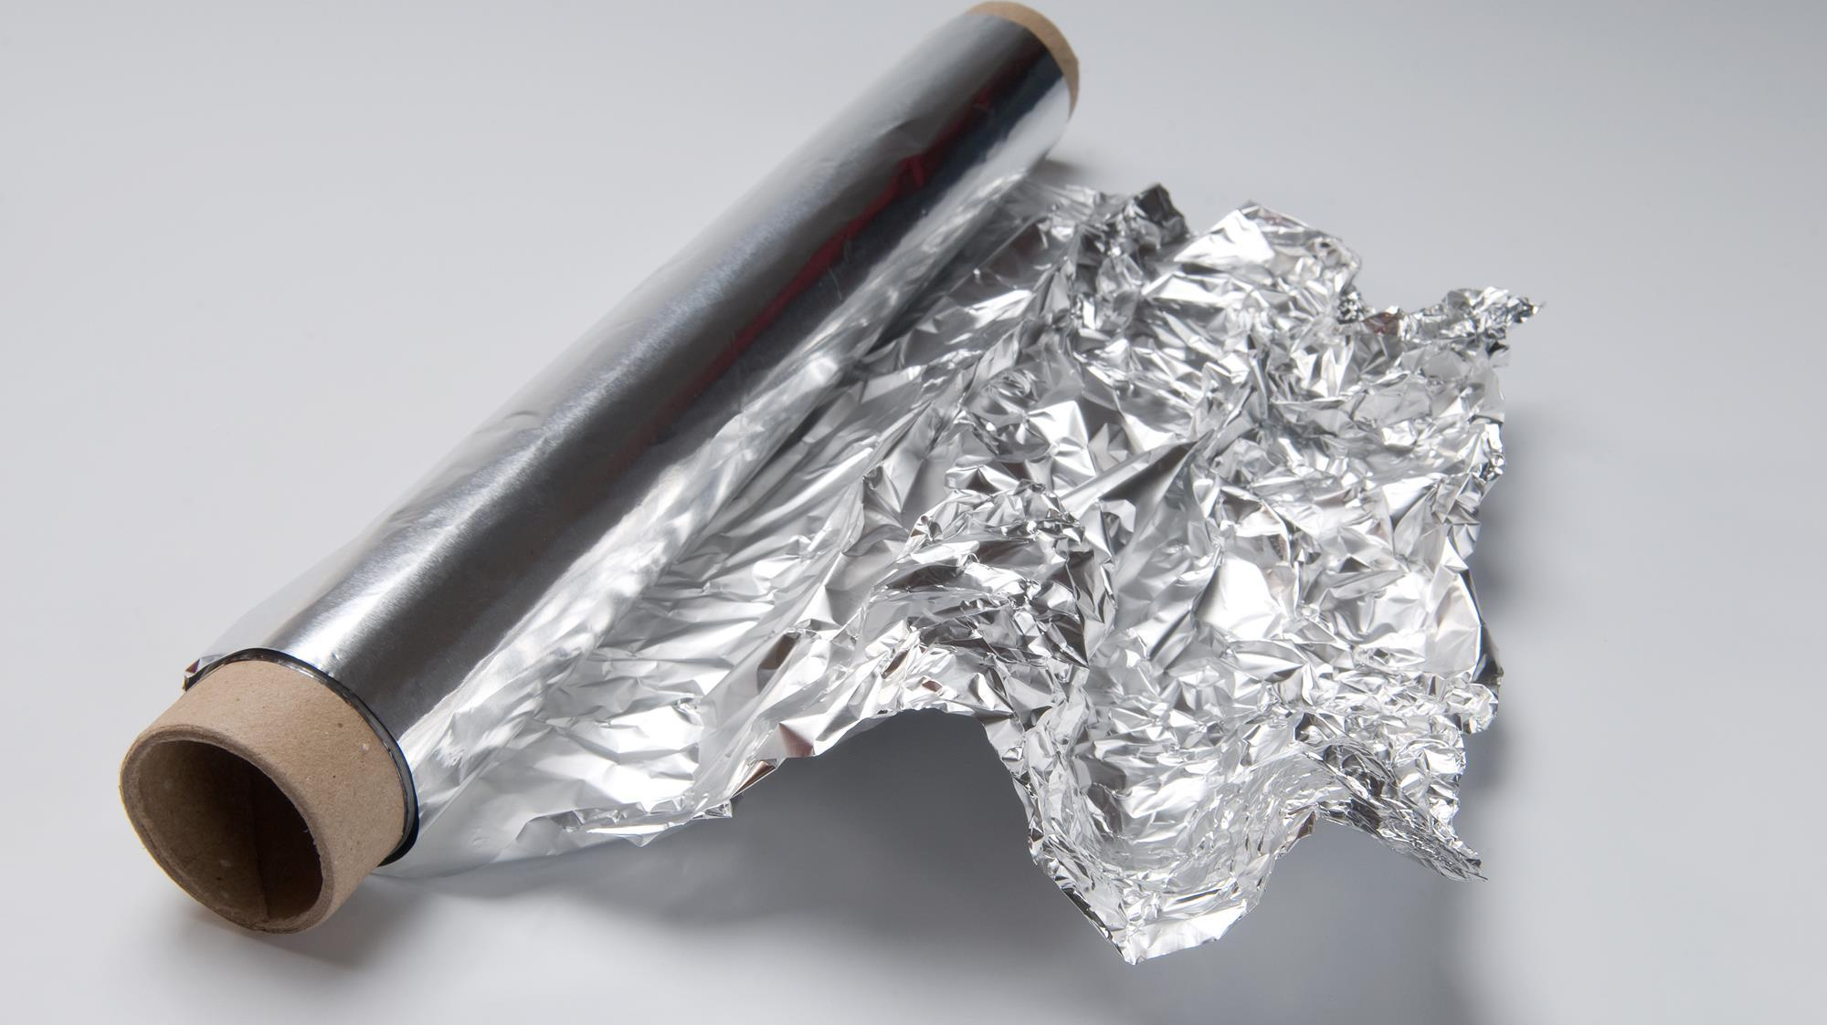
Notes:
70% of plane water too salty drinking irrigation
Desalinate quickly and cheaply?
Electrolysis for aluminium?

Slide 8
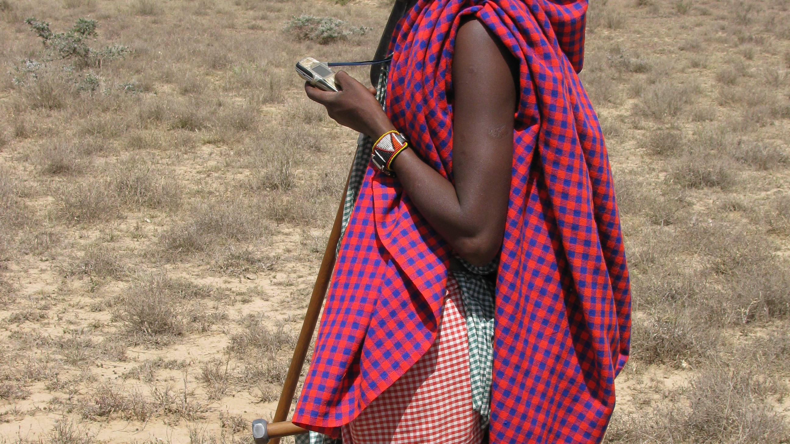

Slide 9
The power of individuals

Slide 10

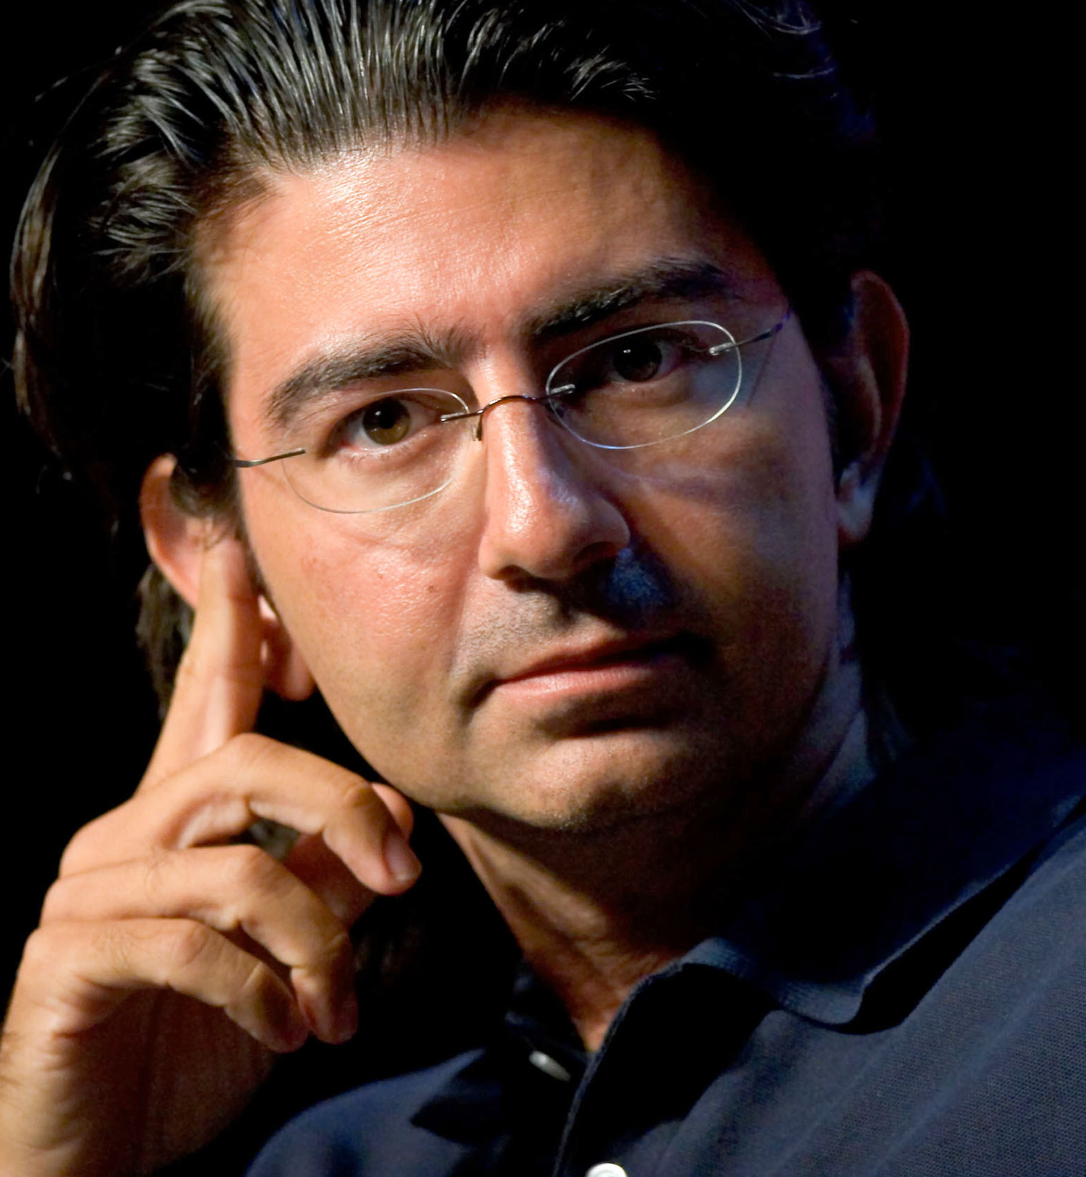
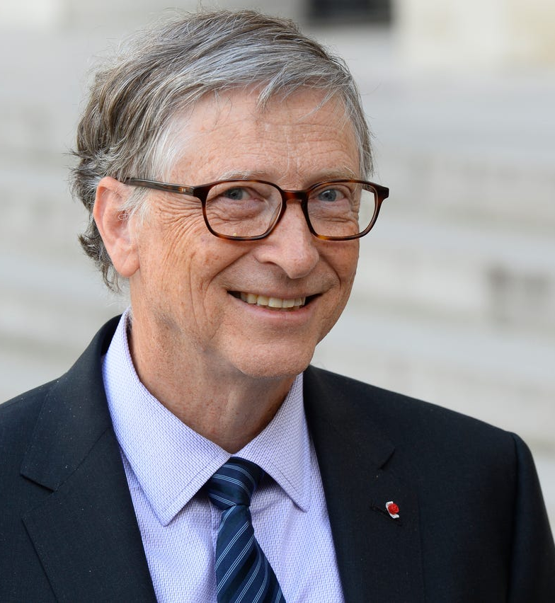
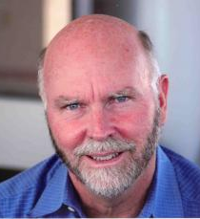

Slide 11
Reversing disaster

Slide 12
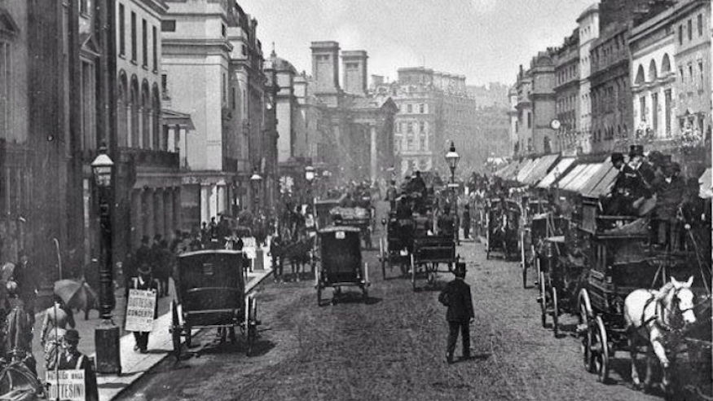

Slide 13


Slide 14

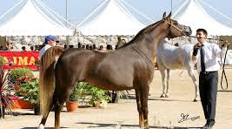


Slide 15
The refinement of commerce

Slide 16



Slide 17


Slide 18
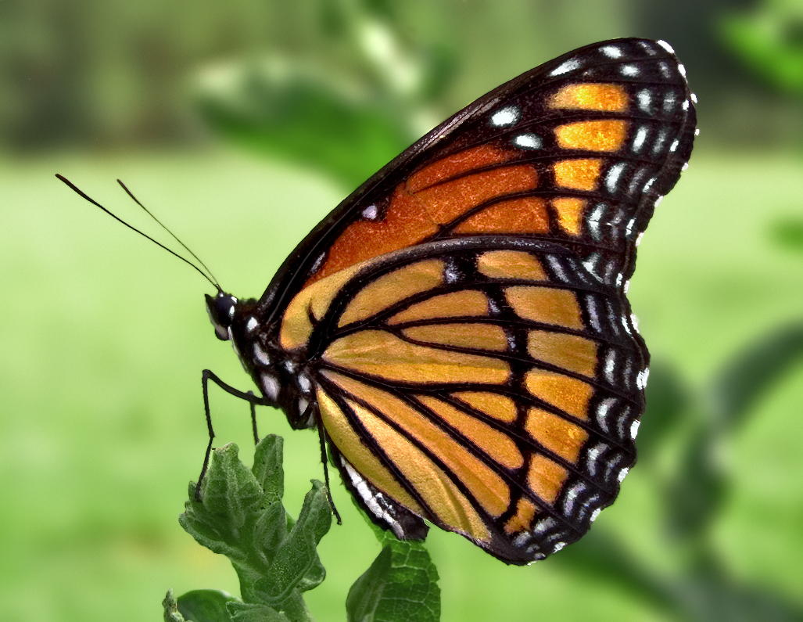
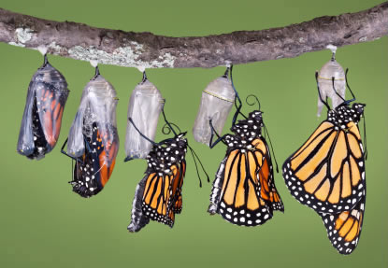
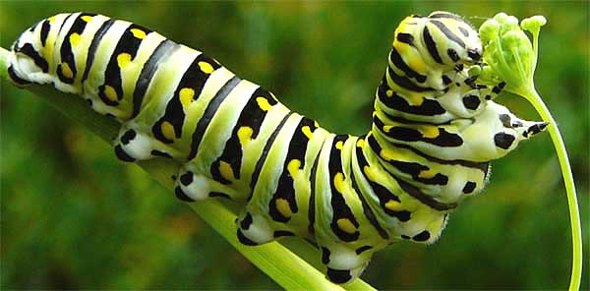

Conscious
Capitalism

Slide 19
Cosco
580 Stores $ 76b
Mercedona 1400 stores $ 21b
QuickTrip
600 stores $ 8b
Trader Joe’s 340 stores $ 8b

Slide 20
1. In all low-income countries across the world today, how many girls finish primary school? C: 60%
2. Where does the majority of the world population live? B: Middle-income
3. In the last 20 years, the proportion of the world population living in extreme poverty has … C: almost halved
4. What is the life expectancy of the world today? C: 70 years
5. There are 2 billion children in the world today, aged 0 to 15 years old. How many children will there be in the year 2100, according to the United Nations C: 2 billion
6. The UN predicts that by 2100 the world population will have increased by another 4 billion people. What is the main reason? B: There will be more adults (age 15 to 74)
7. How did the number of deaths per year from natural disasters change over the last hundred years? C: Decreased to less than half
8. Worldwide, 30-year-old men have spent 10 years in school, on average. How many years have women of the same age spent in school? A: 9 years
9. In 1996, tigers, giant pandas, and black rhinos were all listed as endangered. How many of these three species are more critically endangered today? C: None of them
10. How many people in the world have some access to electricity? C: 80 percent
11. Global climate experts believe that, over the next 100 years, the average temperature will … A: get warmer

Slide 21
331/3 %
17 %

Slide 22
Brains hard-wired
Instinct to dichotomize
Instinct to extremes
Instinct to negativity
Instinct to straight line thinking
Bad and better at the same time

Slide 23

Wishing and hoping
Challenges and solutions
The power of individuals
Reversing disaster
The impact of big data
The refinement of commerce

Slide 24
“Step-by-step, year-by-year, the world is improving. Not on every single measure every single year, but as a rule. Though the world faces huge challenges, we have made tremendous progress. This is the fact-based worldview.”
Professor Hans Rosling, a Swedish physician, academic, and statistician

